Slide 1
P#
<Computational Design Thinking>
<Parametric Design>
P#
BEST PICTURE
Assignment
Context
Course
Date
Parametric
Design
Freshmore
Term 1
Computational
Design Thinking
2023
<Overview Description>
<Part A: Schematic Design>
The idea of building this 3D model is to combine 2 different types of patterns to create a brand new, more interesting parametric design.
The 2 patterns that I used to fuse together is a wave pattern and a rippling effect pattern, which I segregated out in the full Grasshopper code into different groups. (More on what each group of Grasshopper does in the ‘Building Process’ slides 6 and 7)
A key challenge was that I had a lot of ideas on what I want to do for my design but am still lacking the technical knowledge such as the types of functions available in Grasshopper that I can use to achieve my objectives. An example is that I wanted to create volume for my 3D model, since I needed to 3D print it. However, I was not sure how exactly to do it, I explored the idea of ‘stretching’ the 3D model, but the ‘Stretch’ function did not work. Hence after consulting the professors and reading up on the SUTD ASD course notes, I realized that the ‘Extrude’ function is the function I was looking for.

Slide 2
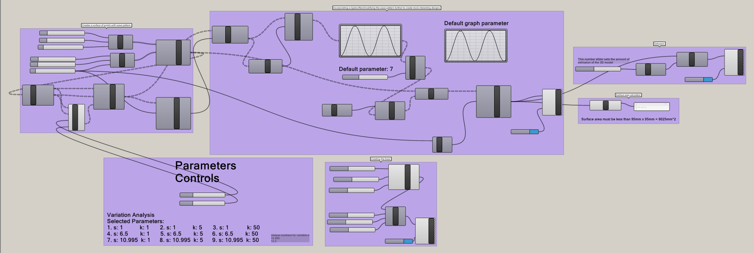
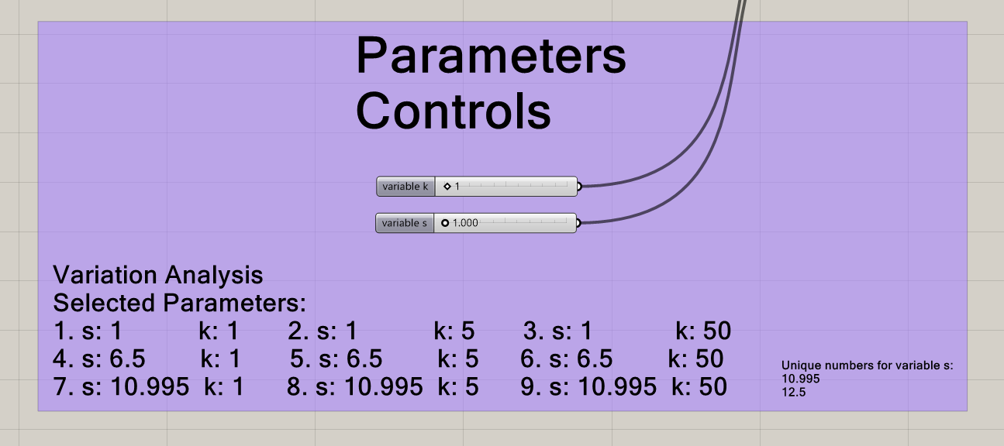
P#
<Computational Design Thinking>
<Parametric Design>
P#
References
<Animation Process>
The GIF animation in the cover page shows the physical change of the 3D model as the number slider that controls parameter s is being changed.
I did not create an animation for the physical change of the 3D model for parameter k as the physical change in the 3D model is too drastic with any small change in parameter k.
Picture 03 shows the physical change of expanding the 3D model as the number slider that controls the number of points on one of the sides in the surface of points group of Grasshopper is increased from 0 to 90.
Picture 04 shows the physical change of the 3D model gradually unflattening as the number slider that controls the amplitude of the rippling effect pattern is being increased from 0 to 10.
<Part B: Variation Analysis>
The parameters that I varied falls under the group of Grasshopper code (see picture 01 for the full Grasshopper code of the 3D model) that creates the wave pattern, with the mathematical formula in the ‘GhPython Script’ command: z = sin(x) + k * sin(y * s), where z is the output parameter connected to the z-coordinates, x and y being constant parameters that also determine the rectangular length and breadth of the 3D model, and the remaining k and s parameters are the parameters that are varied (see picture 02) to create the many variation designs for the ‘Part B: Variation Analysis’ section. (see the next slide for the designs)
For each 3D model variation in the next slide, they are labelled with the value input of the k and s parameters, the surface area, height, material and the time required to 3D print the 3D model variation.
01
UltiMaker. (2023). UltiMaker Cura. Software Download. October 5, 2023 https://ultimaker.com/software/ultimaker-cura/
1/4
02
1/4
03
1/4
Captions
01 Complete Grasshopper code of the 3D model
02 Controls of the 3D model to create each of the 3D model variations for variation analysis Grasshopper of the 3D model
03 Expanding the 3D model
04 Unflattening the 3D model
1/4
04

Slide 3
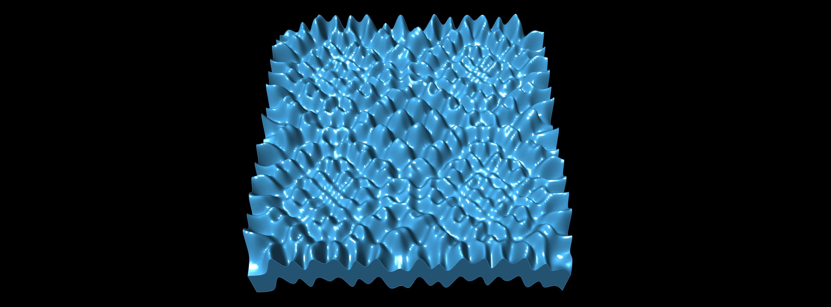
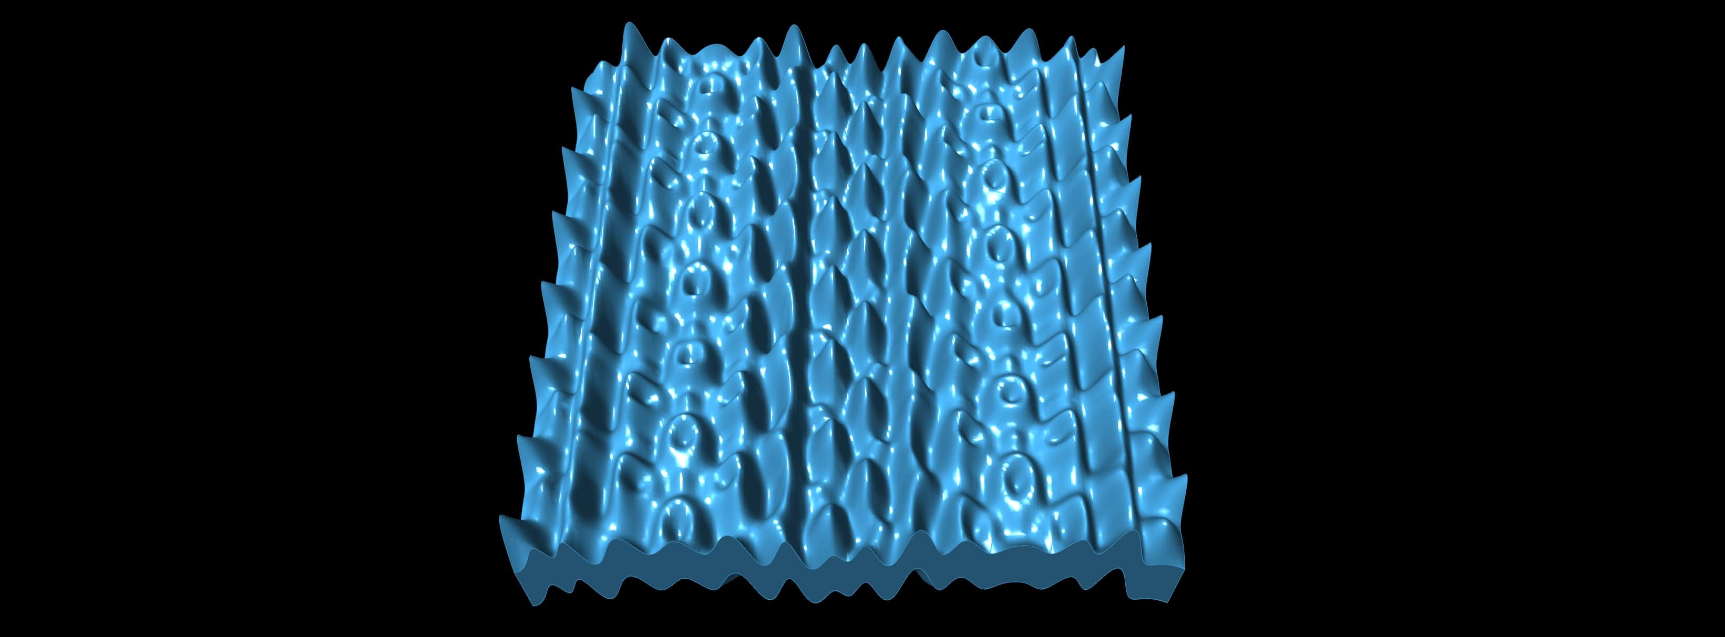
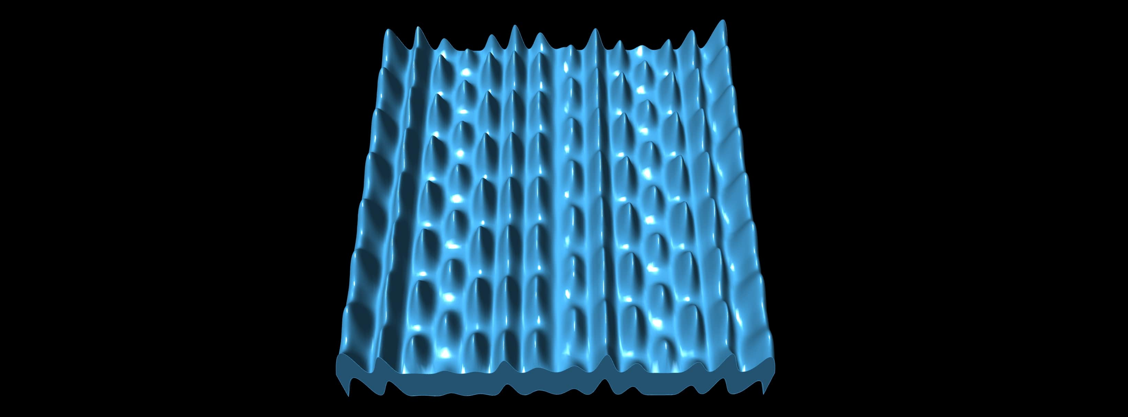
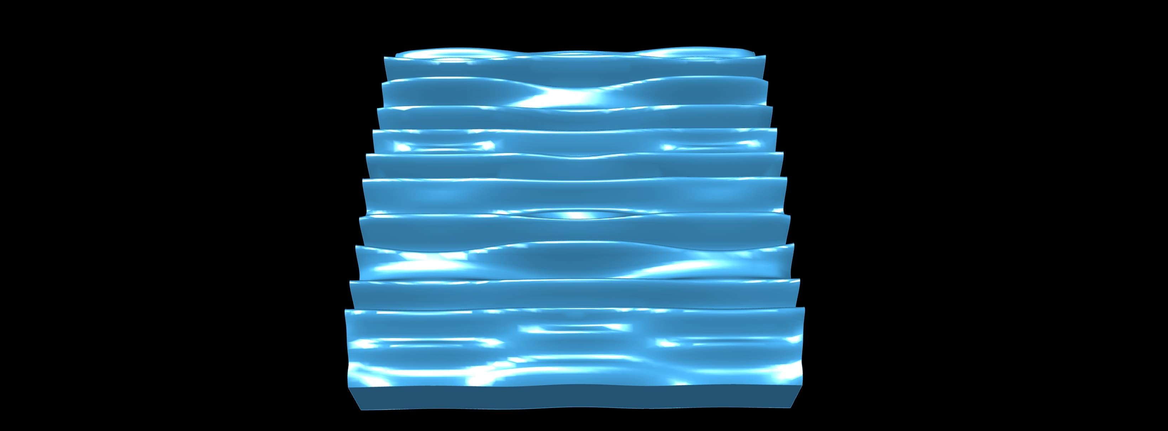
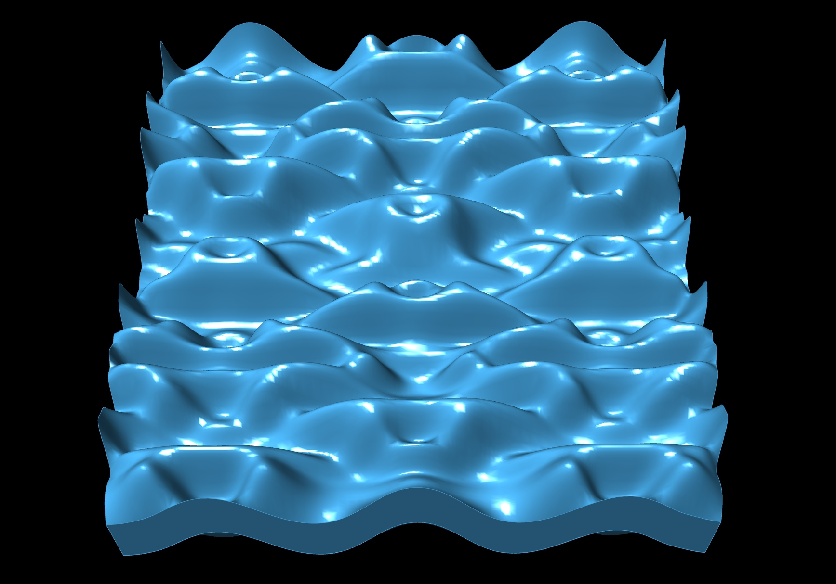
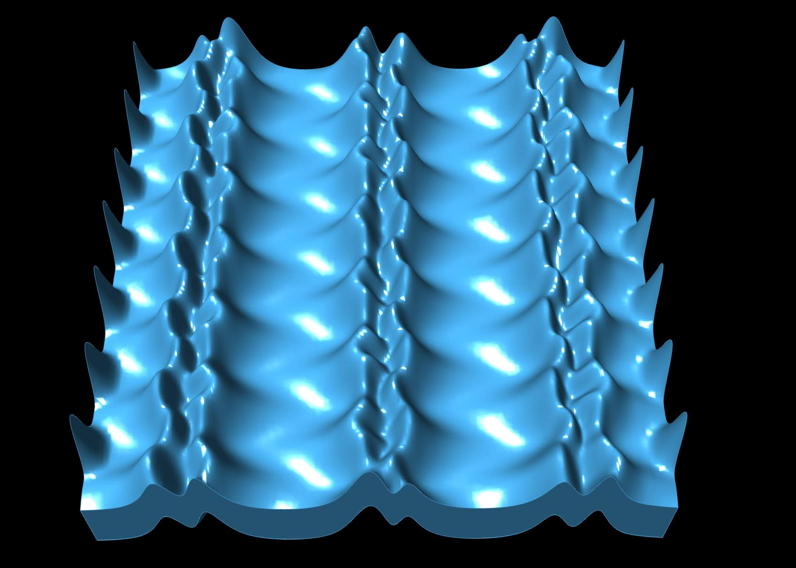
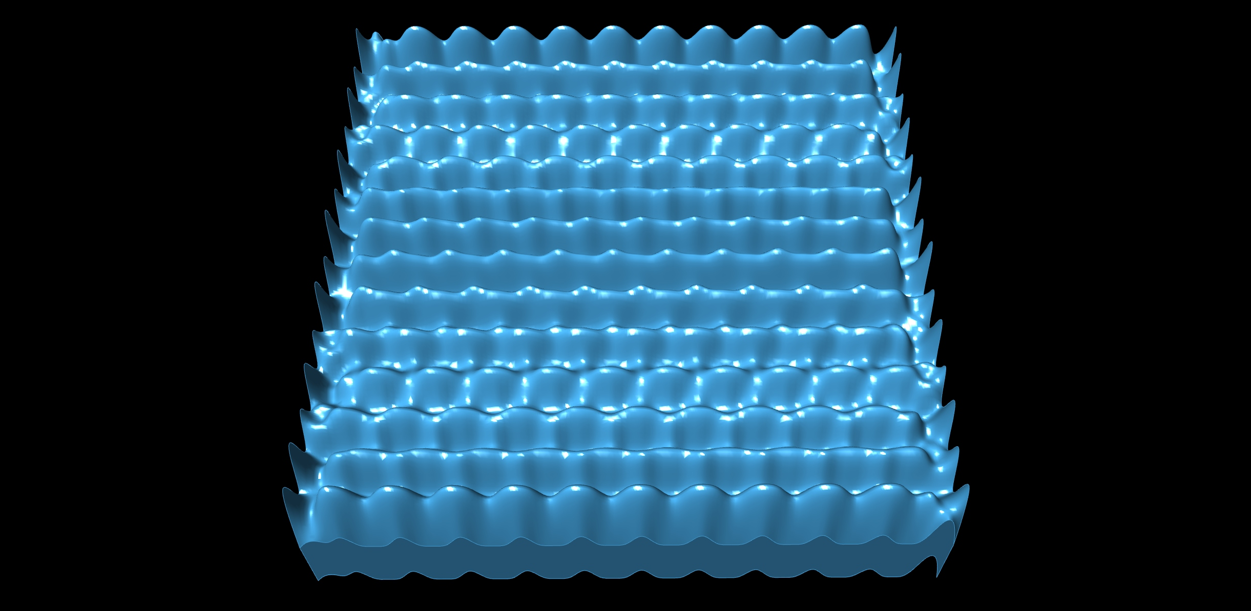
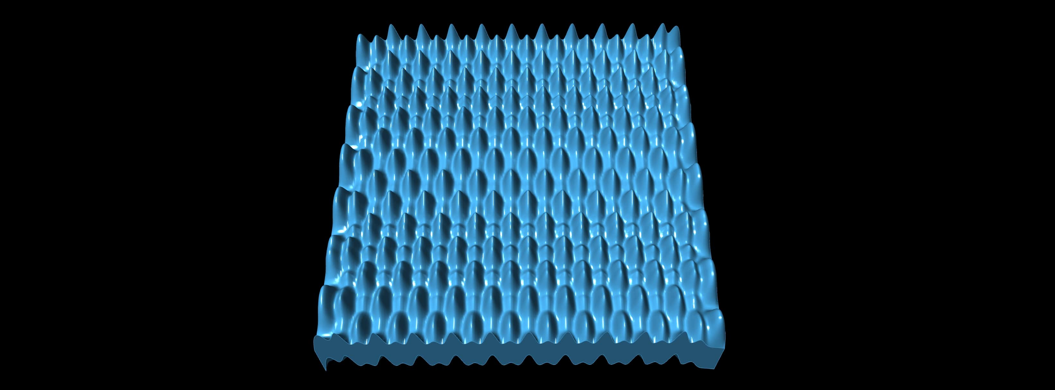
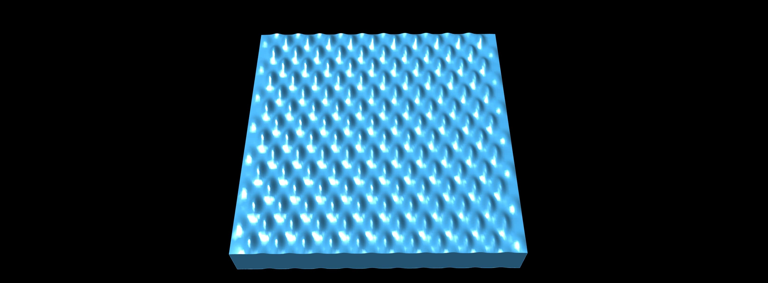
P#
<Computational Design Thinking>
<Parametric Design>
P#
s/k
1
5
50
(Chosen)
04
05
01
1
Parameter s: 1
Parameter k: 1
Surface Area: 3840
Height: 6
Material (PLA) required: 17g
Build duration: 3h 15mins
Parameter s: 1
Parameter k: 5
Surface Area: 4160
Height: 6
Material (PLA) required: 17g
Build duration: 3h 02mins
Parameter s: 1
Parameter k: 50
Surface Area: 4205
Height: 6
Material (PLA) required: 14g
Build duration: 2h 01mins
02
06
07
6.5
Parameter s: 6.5
Parameter k: 1
Surface Area: 3992
Height: 6
Material (PLA) required: 16g
Build duration: 2h 01mins
Parameter s: 6.5
Parameter k: 5
Surface Area: 4160
Height: 6
Material (PLA) required: 16g
Build duration: 2h 22mins
Parameter s: 6.5
Parameter k: 50
Surface Area: 3404
Height: 6
Material (PLA) required: 14g
Build duration: 1h 59mins
Captions
03
08
09
01 Variation analysis 3D model 1
02 Variation analysis 3D model 2
03 Variation analysis 3D model 3
04 Variation analysis 3D model 4
05 Variation analysis 3D model 5
06 Variation analysis 3D model 6
07 Variation analysis 3D model 7
08 Variation analysis 3D model 8
09 Variation analysis 3D model 9
10
.995
Parameter s: 10.995
Parameter k: 1
Surface Area: 4312
Height: 6
Material (PLA) required: 17g
Build duration: 2h 45mins
Parameter s: 10.995
Parameter k: 5
Surface Area: 4160
Height: 6
Material (PLA) required: 16g
Build duration: 2h 51mins
Parameter s: 10.995
Parameter k: 50
Surface Area: 2315
Height: 6
Material (PLA) required: 11g
Build duration: 1h 34mins

Slide 4
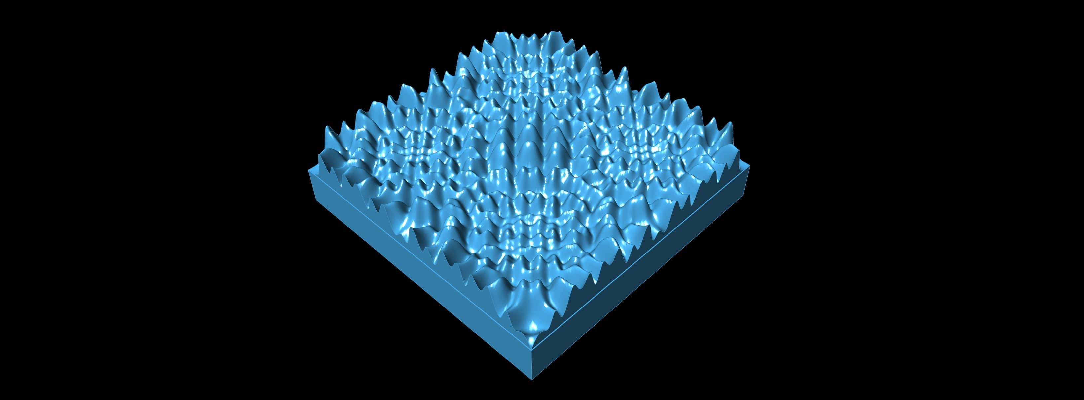
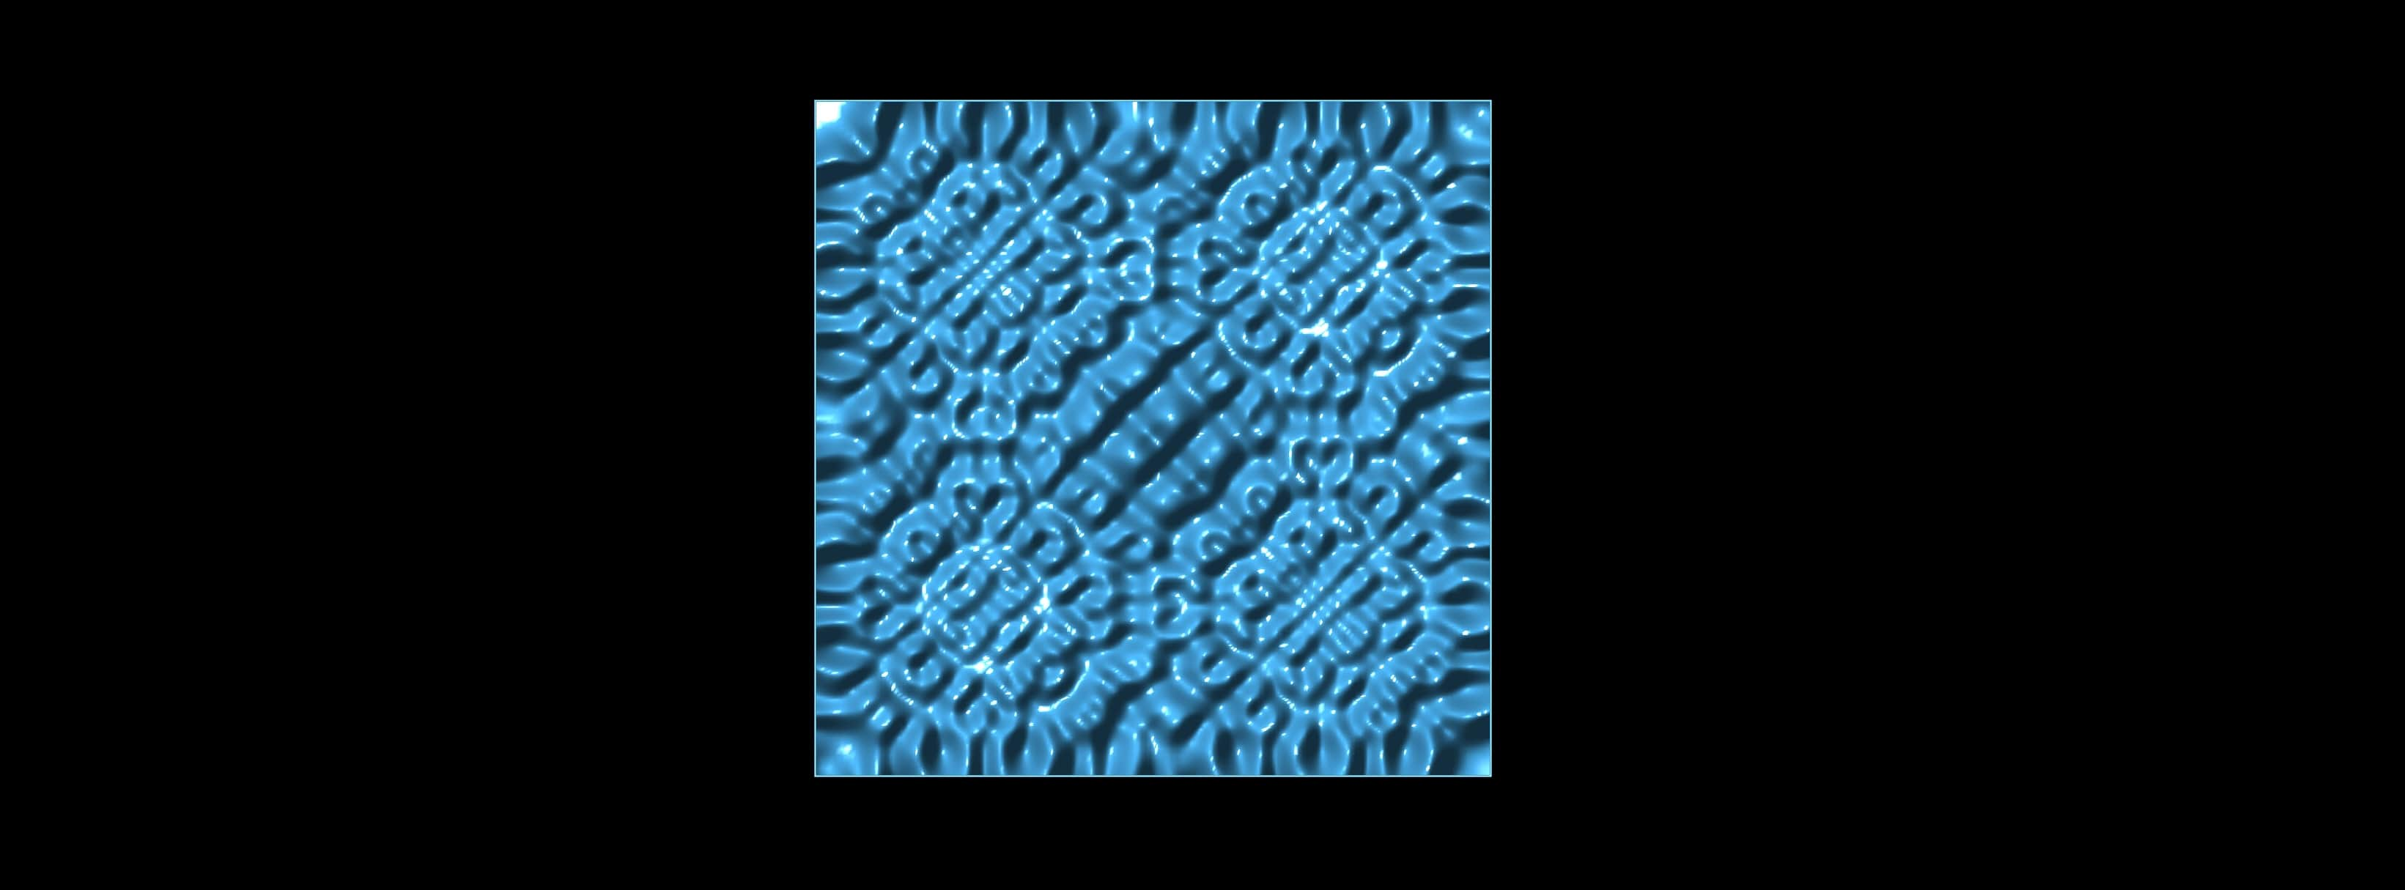
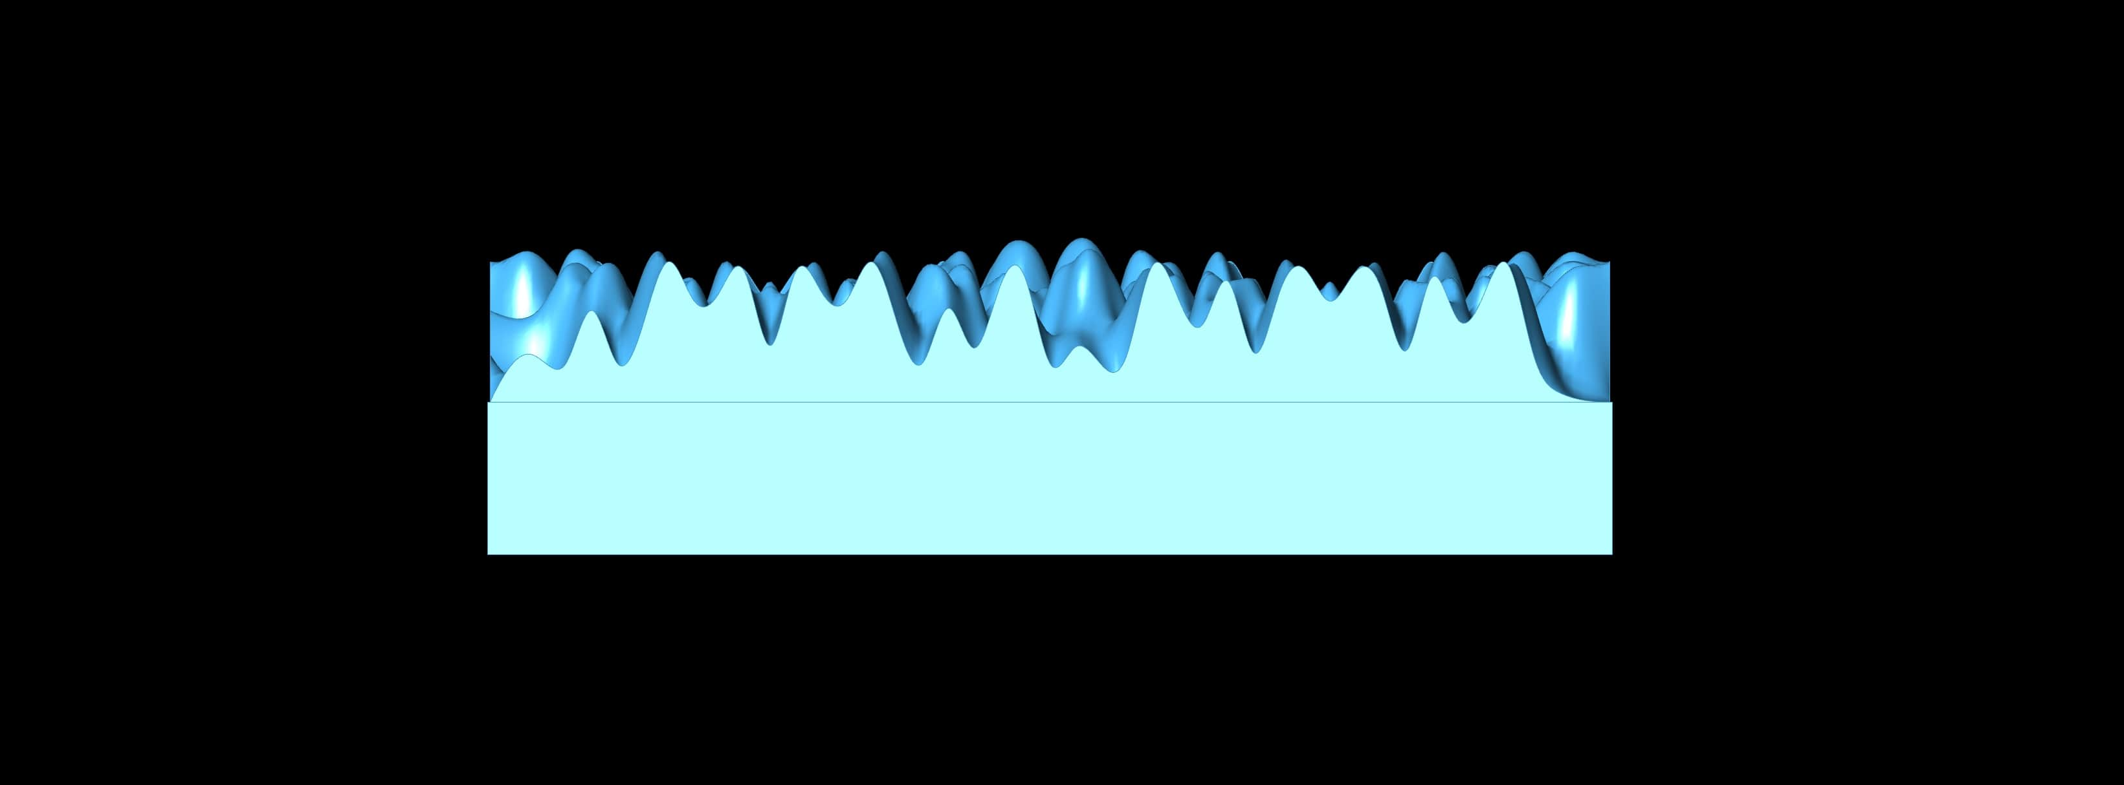
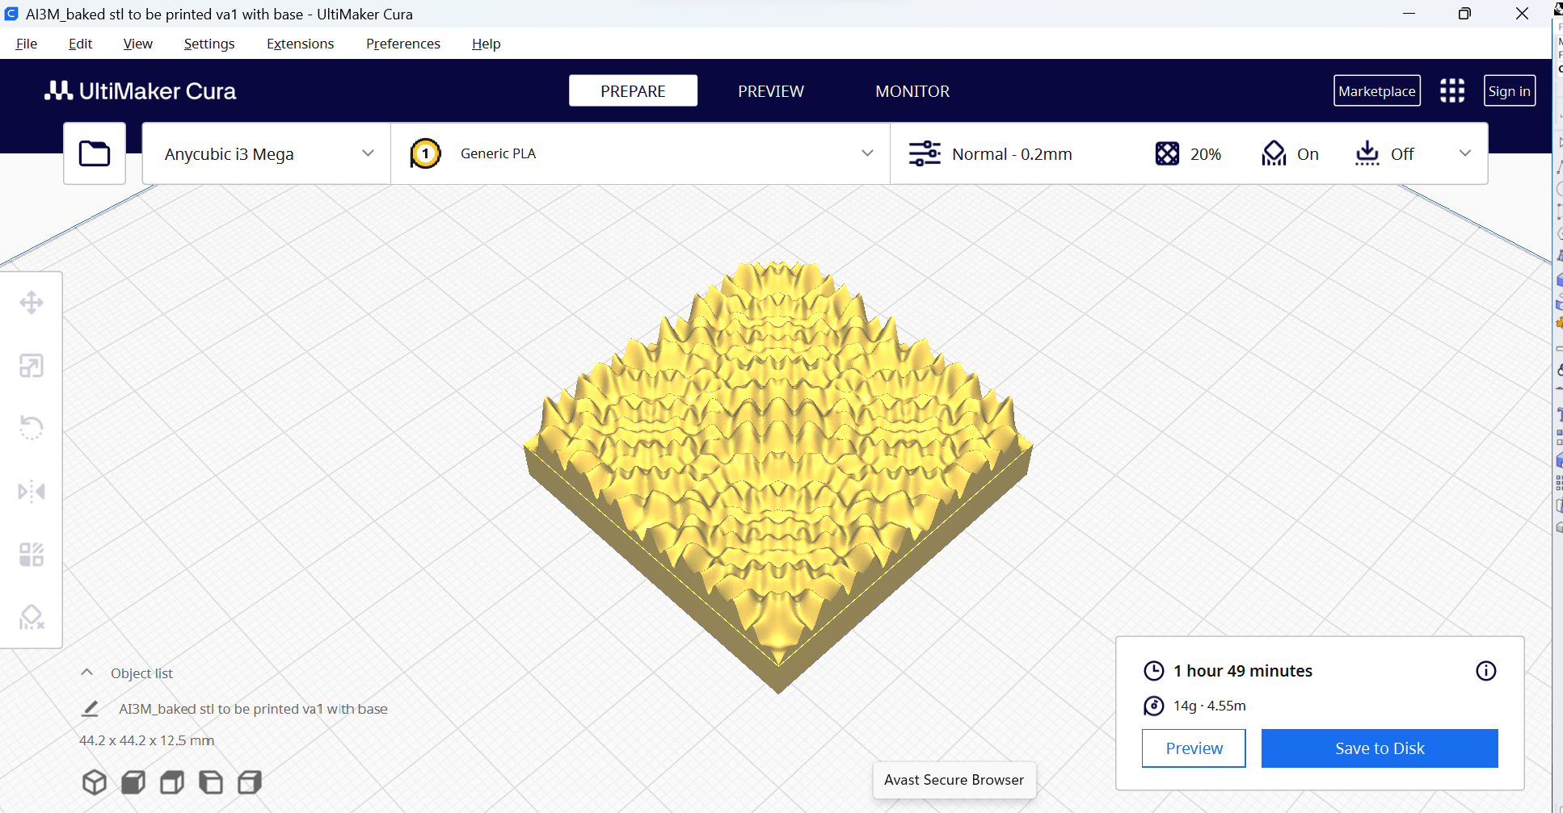
P#
<Computational Design Thinking>
<Parametric Design>
P#
References
<Part C: Design Evaluation>
See the next slide for the final design map evaluating the 3D model variations as shown from the previous slide using the two evaluation criteria dimensions, qualitative (columns) and quantitative (rows) evaluation.
Quantitative Evaluation:
For my 3D model variations, the 2 main factors I used for quantitative evaluation of the 3D model variations are the material required and the time required to build the 3D model. I intend to use the material required to gauge the relative costs of the 3D model variations.
The material and time required to build each 3D model variation is found using the UltiMaker Cura software.
Qualitative Evaluation:
I also organized the 3D model variations in the final design map based on their aesthetic and complexity of their designs.
<Part D: Rapid Prototyping>
Out of all the variations, I have decided to 3D print ‘Variation Analysis 3D model 1’ (see picture 01) due to its highest aesthetic and complexity of its design. Furthermore, due to the relatively small scale of the 3D model, the material and time required should not be a big issue during the 3D printing process.
In addition, I decided to add a square base to the 3D model variation to make the 3D printing process even smoother by providing a solid foundation for the 3D model variation to be built on top of and simplify the 3D building process.
Using the UltiMaker Cura software, it shows that the 3D model variation requires 14g of Polylactic Acid (PLA) filament and a time of 1 hour and 49 minutes to 3D print the 3D model variation at the dimensions of 44.2mm x 44.2mm x 12.5mm, which I believe is quite a manageable amount of resources. I also believe that if the design proves too complicated to re-create physically, I can upscale the printed 3D model.
01
UltiMaker. (2023). UltiMaker Cura. Software Download. October 5, 2023 https://ultimaker.com/software/ultimaker-cura/
1/4
02
1/4
03
1/4
Captions
01 Perspective view of the 3D model
02 Top view of the 3D model
03 Side view of the 3D model
04 Details of printing the 3D model in the Ultimaker Cura software
1/4
04

Slide 5

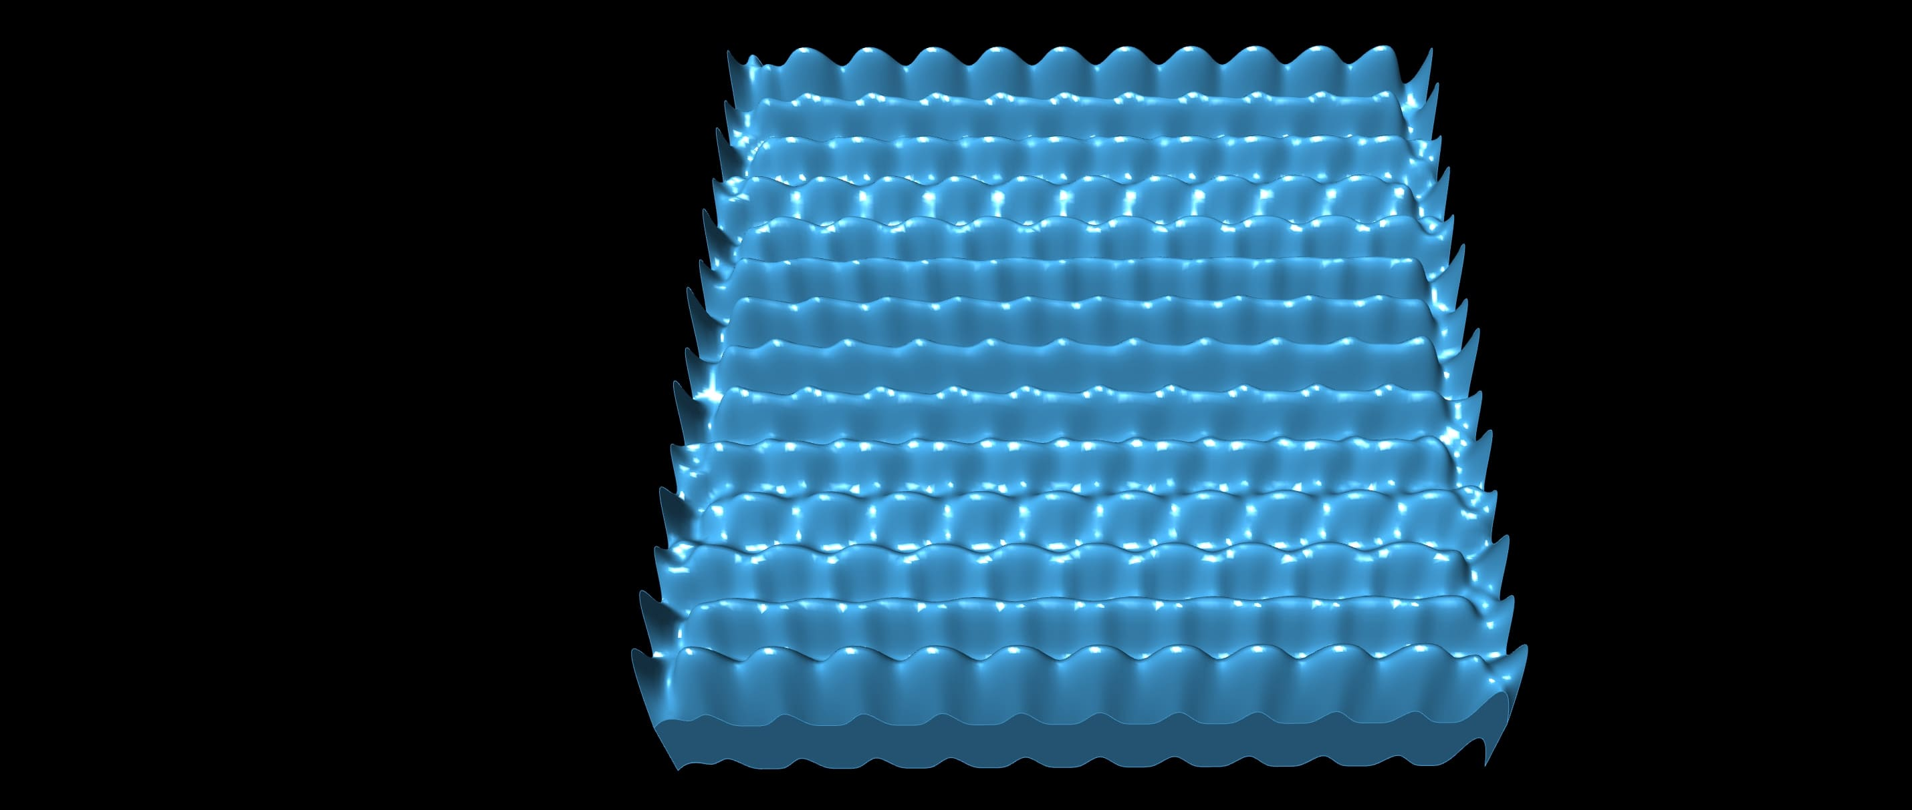
P#
<Computational Design Thinking>
Quantitative
<Parametric Design>
P#
Low
High
01
05
Parameter s: 10.995
Parameter k: 50
Surface Area: 2315
Height: 6
Material (PLA) required: 11g
Build duration: 1h 34mins
Parameter s: 10.995
Parameter k: 5
Surface Area: 4160
Height: 6
Material (PLA) required: 16g
Build duration: 2h 51mins
06
02
1/4
Parameter s: 6.5
Parameter k: 1
Surface Area: 3992
Height: 6
Material (PLA) required: 16g
Build duration: 2h 01mins
Parameter s: 6.5
Parameter k: 5
Surface Area: 4160
Height: 6
Material (PLA) required: 16g
Build duration: 2h 22mins
Qualitative
1/4
03
07
Captions
01 Variation analysis 3D model 9
02 Variation analysis 3D model 2
03 Variation analysis 3D model 5
04 Variation analysis 3D model 4
05 Variation analysis 3D model 8
06 Variation analysis 3D model 6
07 Variation analysis 3D model 3
08 Variation analysis 3D model 1
Parameter s: 1
Parameter k: 50
Surface Area: 4205
Height: 6
Material (PLA) required: 14g
Build duration: 2h 01mins
Parameter s: 10.995
Parameter k: 1
Surface Area: 4312
Height: 6
Material (PLA) required: 17g
Build duration: 2h 45mins
(Chosen)
1/4
04
08
Parameter s: 1
Parameter k: 5
Surface Area: 4160
Height: 6
Material (PLA) required: 17g
Build duration: 3h 02mins
Parameter s: 1
Parameter k: 1
Surface Area: 3840
Height: 6
Material (PLA) required: 17g
Build duration: 3h 15mins
High

Slide 6
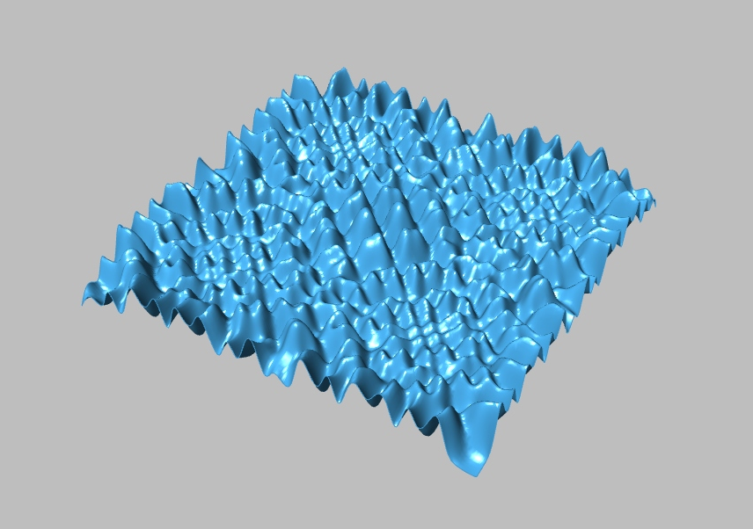
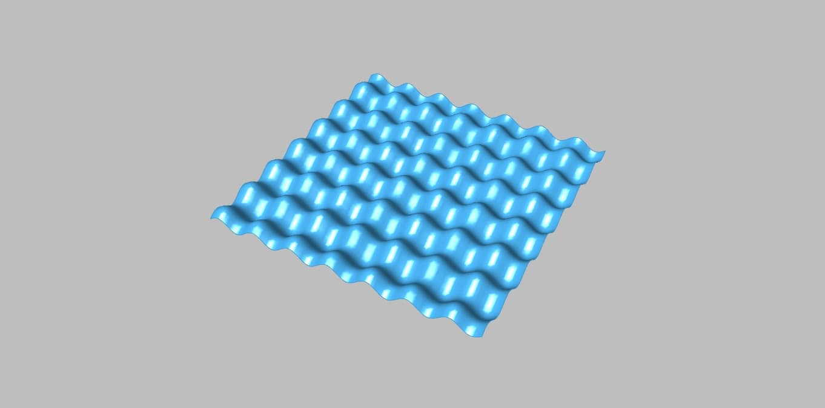
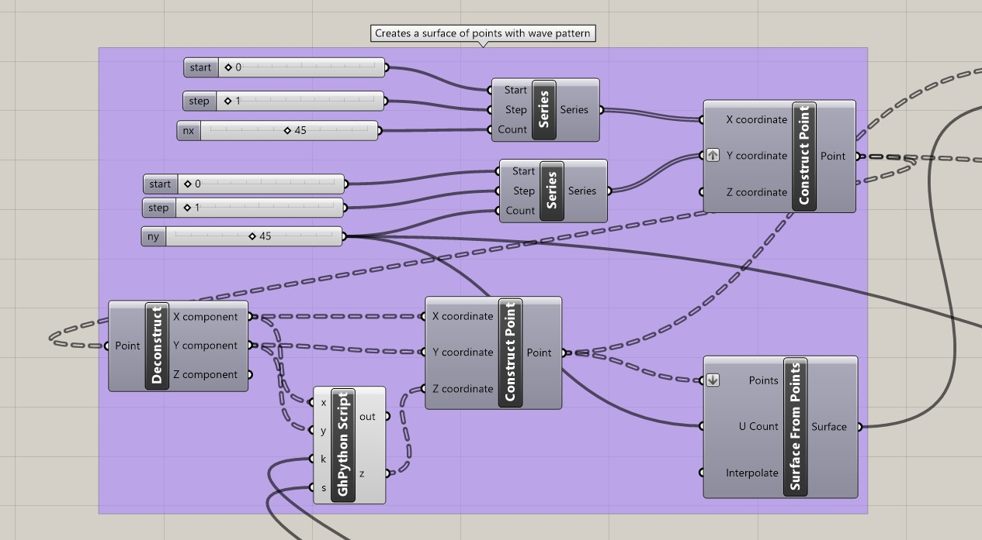
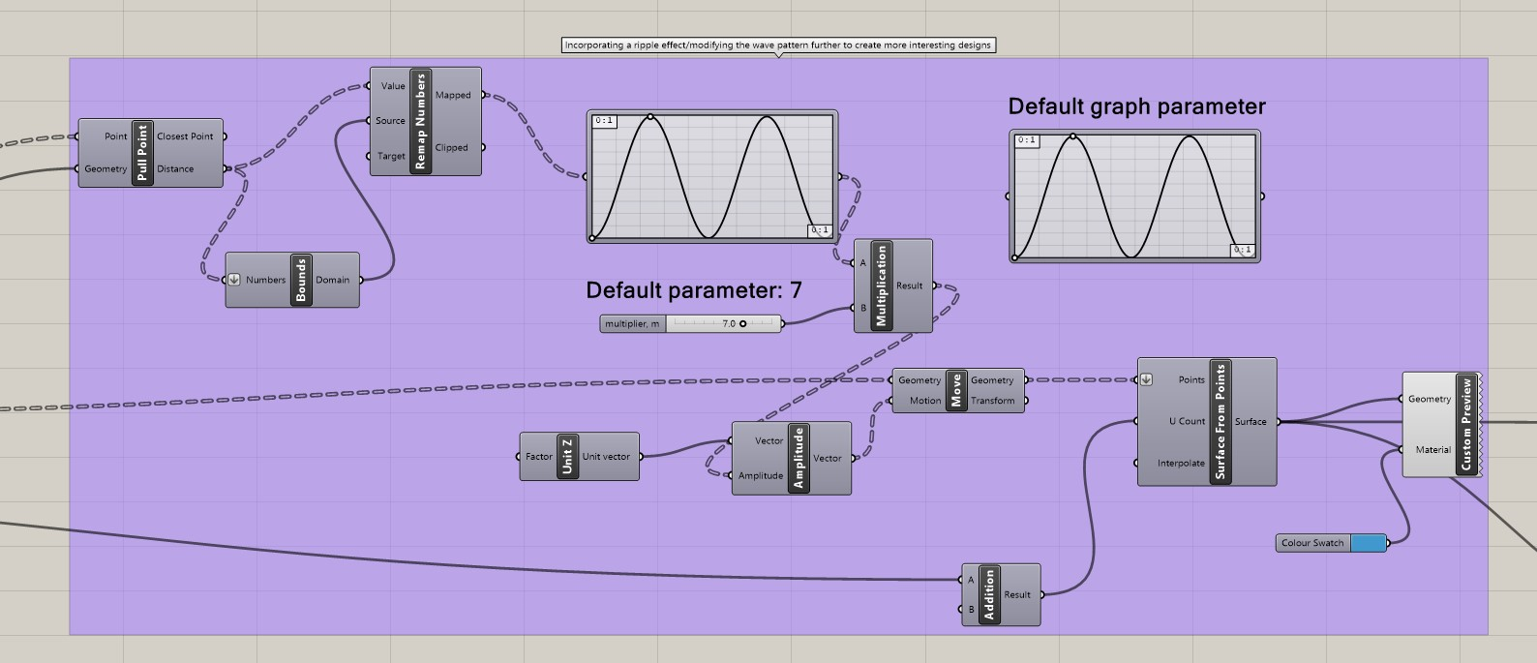
P#
<Computational Design Thinking>
<Parametric Design>
P#
References
<Building Process Part 1>
Step 1 of building the 3D model is by creating a wave pattern. The idea was inspired from the SUTD. “Computational Thinking and Design, Data Landscapes Complex Patterns” ASD course notes. It is done by first created a surface of points, then creating a solid surface out of the surface of points via the function ‘Surface from Points’ in Grasshopper, then using the mathematical function, z = sin(x) + k * sin(y * s), created in Python to create the wave pattern. (see picture 01 for the model and picture 03 for the Grasshopper code).
Step 2 of building the 3D model is by creating the rippling effect pattern and combining it to the wave pattern created in step 1. The idea was inspired from the Youtube channel architutors’s “Easy Grasshopper Tutorial (3d Parametric Design)” Youtube video. (see picture 02 for the model and picture 04 for the Grasshopper code)
02
SUTD. “Computational Thinking and Design, Data Landscapes Complex Patterns” ASD course notes. 2020 http://asd.courses.sutd.edu.sg/cdt/data-landscapes/2/
architutors. “Easy Grasshopper Tutorial (3d Parametric Design)” YouTube video. March 1, 2021 https://www.youtube.com/watch?v=nwyZ8iephSE
01
03
03
Captions
01 Solid surface of points
02 Fusion of wave pattern and rippling effect pattern
03 Grasshopper code to create the model in ‘01’
04 Additional Grasshopper code to create the model in ’02’
04

Slide 7
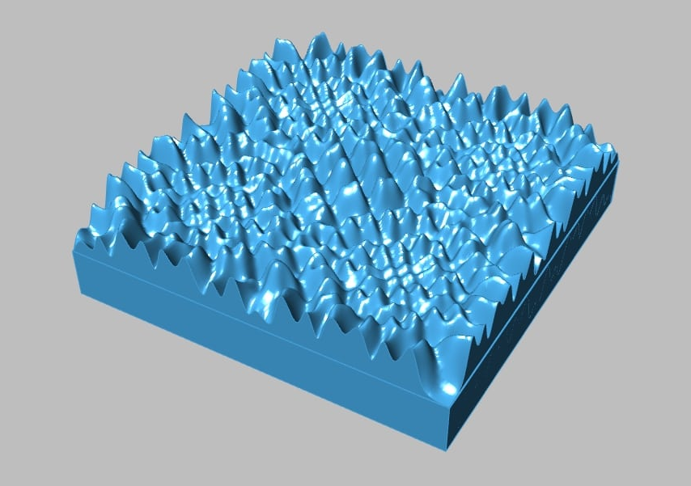
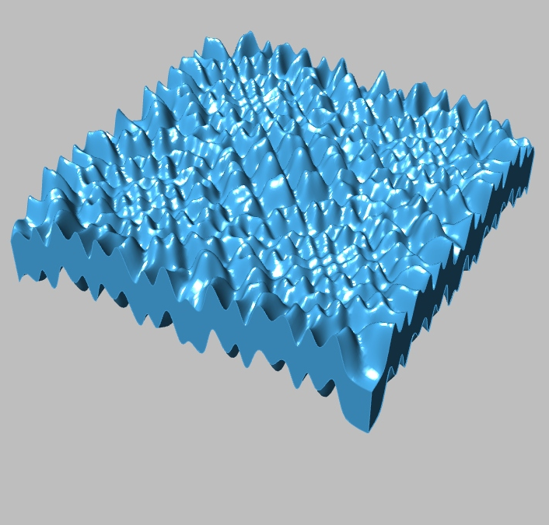
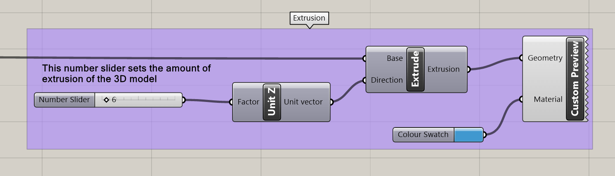
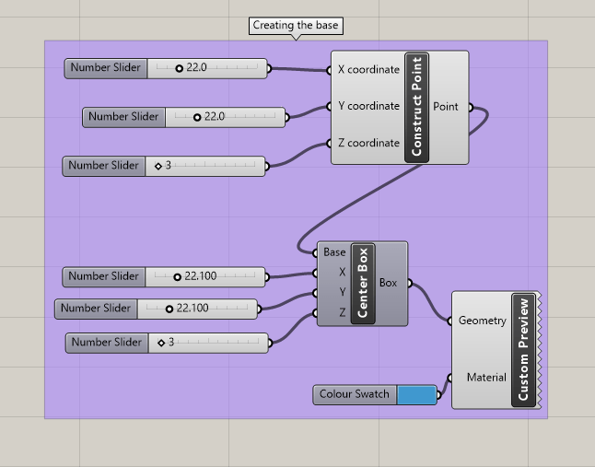
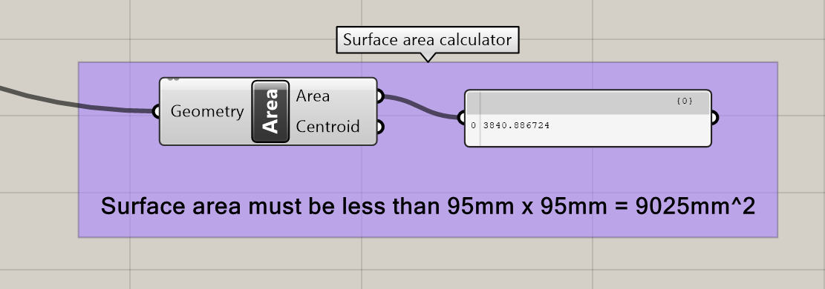
P#
<Computational Design Thinking>
<Parametric Design>
P#
<Building Process Part 2>
Step 3 of building the 3D model is by extruding via the ‘Extrude’ function in Grasshopper so that we can give the 3D model volume so that it can be 3D printed. (see picture 01 for the model and picture 03 for the Grasshopper code).
Step 4 of building the 3D model is by creating a separate square base using simple functions such as the ‘Center Box’ to create the square base, and ‘Construct Point’ to set the desired location to place the square base. (see picture 02 for the model and picture 04 for the Grasshopper code)
The surface area label for the 3D model variations in the ‘Part B: Variation Analysis’ section is found using the ‘Area’ function in Grasshopper and a ‘Panel’ function to display the value of the surface area (see picture 05), while the height is determined by the amount of extrusion of the 3D model in step 3.
02
02
01
01
03
03
Captions
01 Extrusion of the 3D model
02 Adding a square base to the model
03 Additional Grasshopper code to create the model in ‘01’
04 Additional Grasshopper code to create the model in ‘02’
05 Grasshopper code to find surface area of the model
04
05
1/8

